Slide 1

Title slide

Slide 2
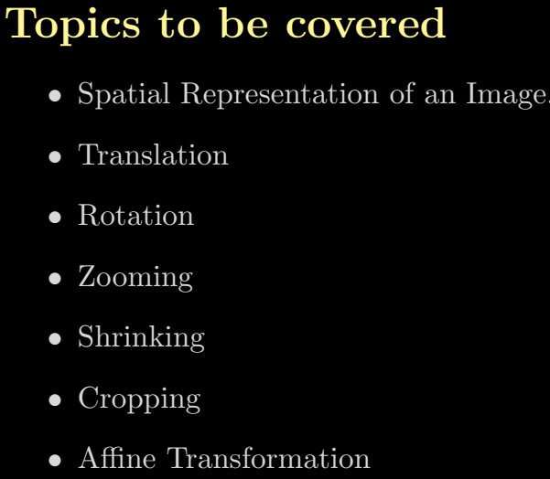
Title slide

Slide 3
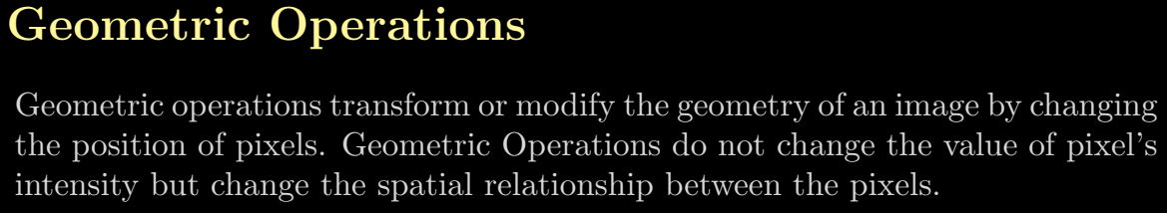
Title slide

Slide 4
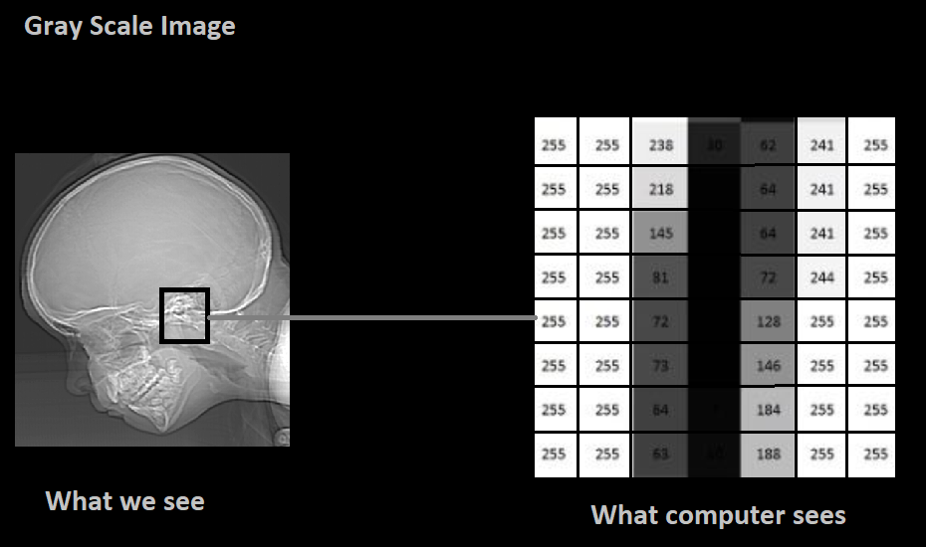
How does Computer see the image ?
Title slide

Slide 5
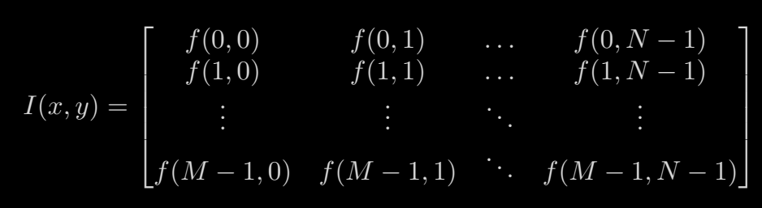
Title slide

Slide 6
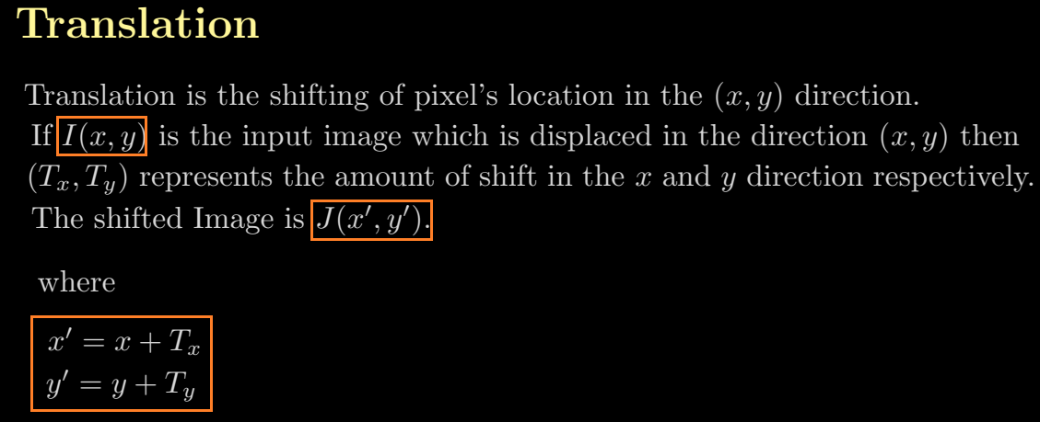
Title slide

Slide 7
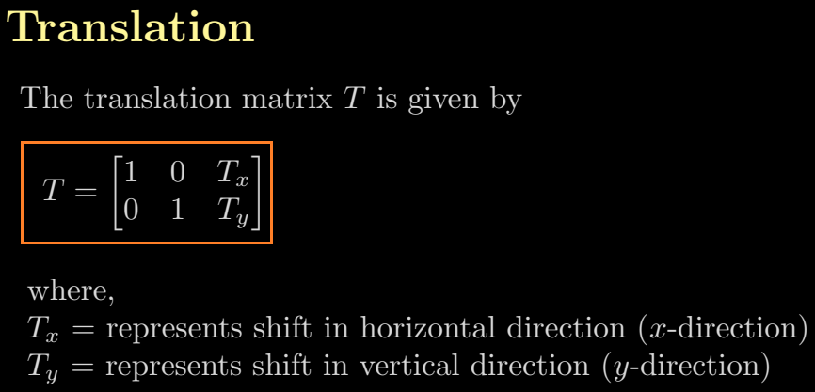
Title slide

Slide 8
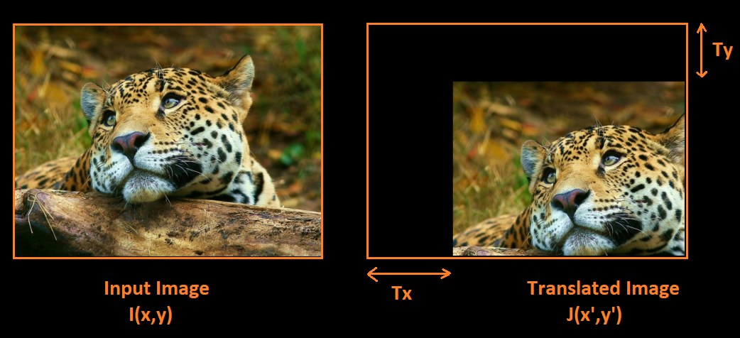
Title slide

Slide 9
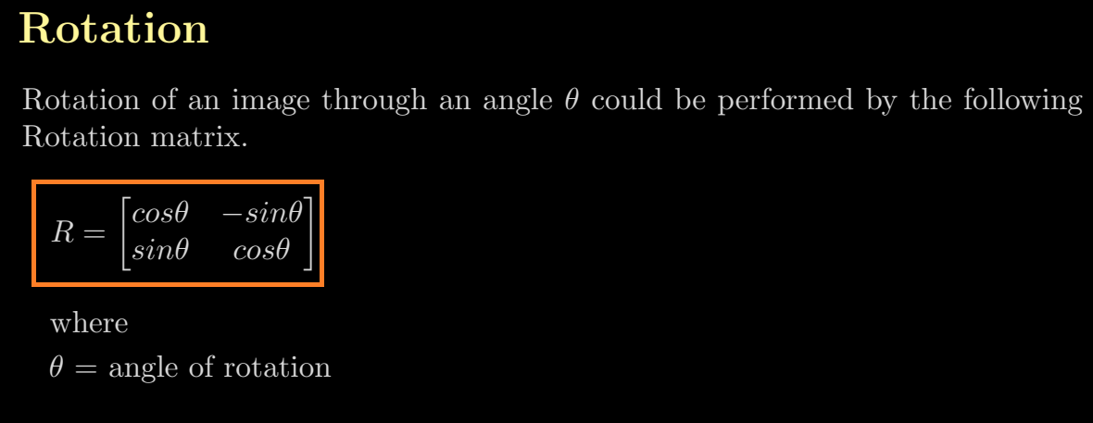
Title slide

Slide 10
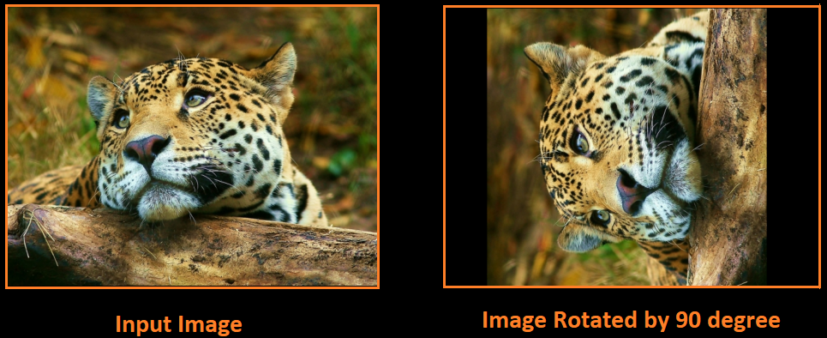
Title slide

Slide 11
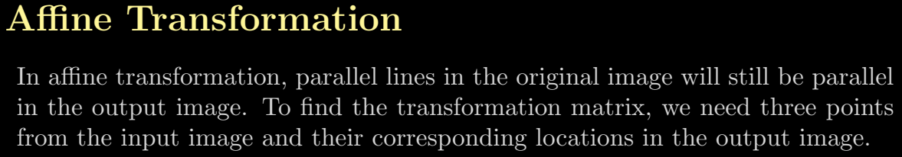
Title slide

Slide 12

Title slide

Slide 13
Title slide

